Slide 1
Weekly Assignments
Junit Lab
Quiz
Activity 1.1
Project 1

Slide 2
ModernC
“You can’t learn a programming language without practicing it. You must have a decent programming environment at your disposal, and you must master it to some extent.”
Jens Gustedt, ModernC
https://modernc.gforge.inria.fr/

Slide 3
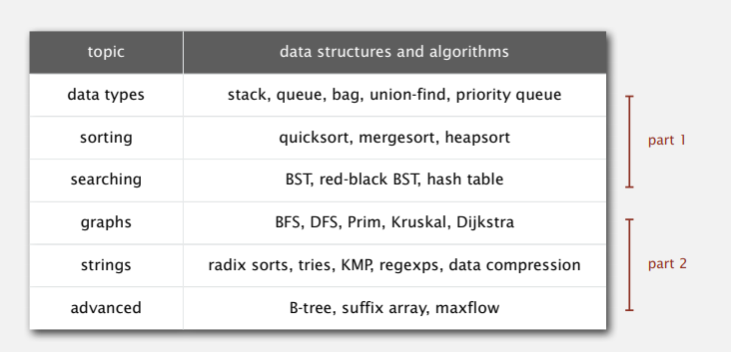
Algorithms, Parts I & II
Princeton | Coursera
Notes:
CMSC 204 is a “classic” computer science course. It’s being taught everywhere

Slide 4
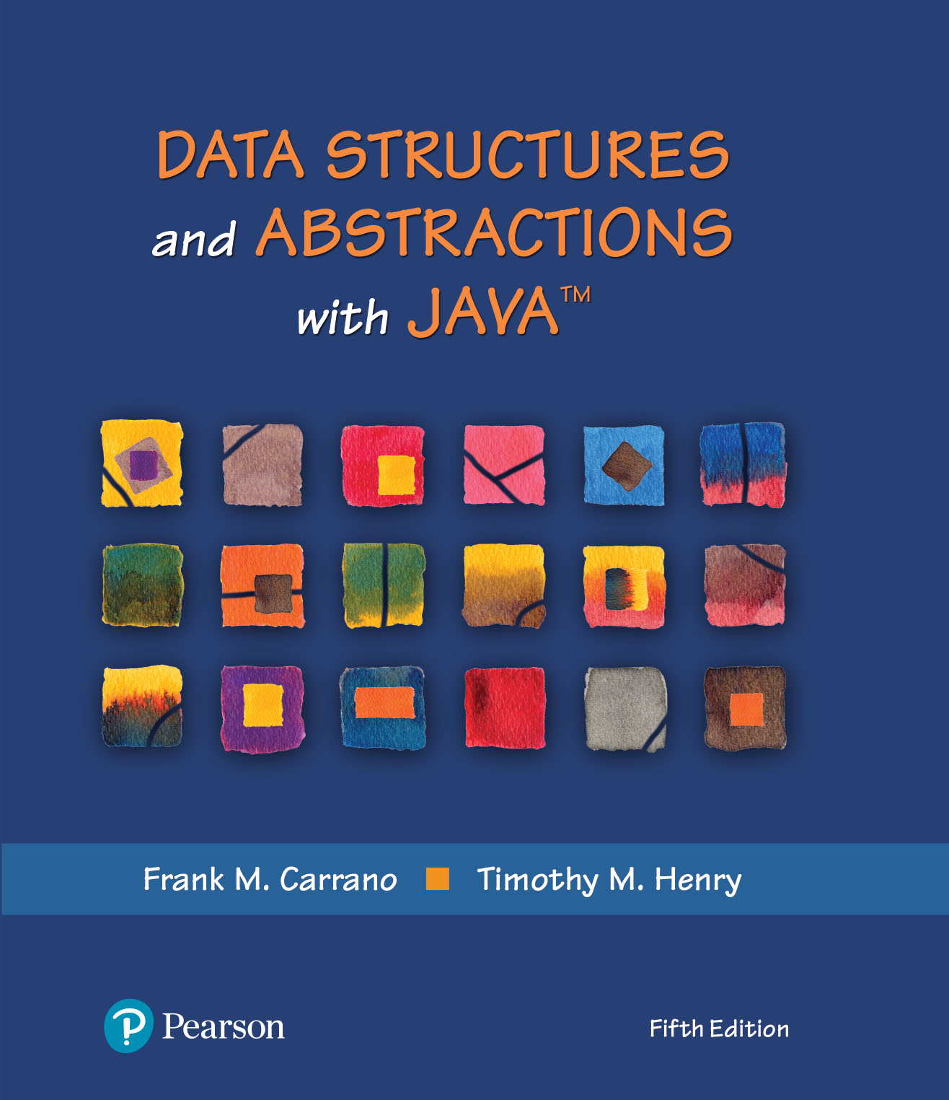
Bags | Chapter 1

Slide 5
Video Notes | Learning Strategy
Designing an ADT
https://mediaplayer.pearsoncmg.com/assets/secs-vn-ch01a-designing-an-adt
Learning Strategy | My Recommendations
Each chapter (of our textbook) includes a set of video notes
Available under Course Content
Watch them first – they will help with your learning
Mastering Course Topics
Watch videos
Review provided PPTs next
Read our text (last)
Notes:
To maximize your learning experience, prepare for class prior each week

Slide 6
Abstract Data Type (ADT)
Notes:
What are the primitive data types?

Slide 7
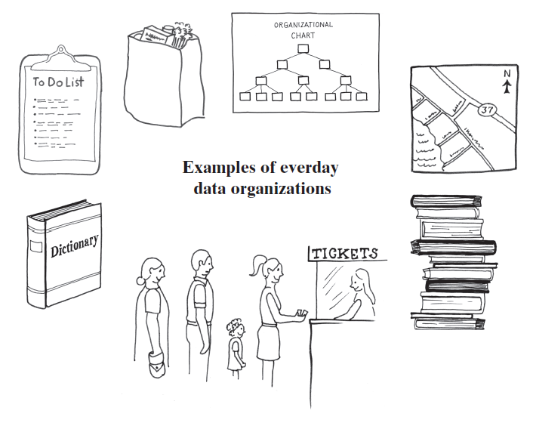
Data Organization in Life
What data are you dealing every day?
Road map
Standing in line
Stack of books
Dictionary
To-do list
Data on computer
Notes:
Your mobile phone (any device) would not be very useful without data
Up to this point, we “learn” how to program
Time to start thinking about data - 204

Slide 8
Data Organization
Primitive vs. Abstract Data Type
Data that is stored
Operations on that data
What does this remind you of ?
Data Structure – implementation of a ADT
Collection – ADT that contains a group of objects
Bag
List
Stack & Queue
Dictionary
Tree
Graph
Notes:
Computers need a way to organize and manipulate data (in memory in particular)
Additional resources
https://opendsa-server.cs.vt.edu/ODSA/Books/CS3/html/ADT.html
*** | Example 1.2.4
https://www.geeksforgeeks.org/abstract-data-types/
http://web.mit.edu/6.005/www/fa14/classes/08-abstract-data-types/
ME
https://www.cs.princeton.edu/courses/archive/fall20/cos126/lectures/CS.8.ADTs-2x2.pdf
http://www2.cs.siu.edu/~tmengistu/Courses/Fall2015/CS220/Slides/Abstract%20Data%20Types.pdf
https://www.cs.umb.edu/~bobw/CS210/Lecture06.pdf

Slide 9
ADT Car | Example
When operating a car, the primary activities are steering, accelerating, and braking
This design for cars can be viewed as an ADT with operations "steer", "accelerate", and "brake"
Two cars (from two different automakers) might implement these operations in radically different ways, say with different types of engine, or front- versus rear-wheel drive
Most drivers can operate any of them
ADT presents a uniform method of operation that does not require the driver to understand the specifics of any particular engine or drive design
These differences are deliberately hidden
Notes:
https://opendsa-server.cs.vt.edu/ODSA/Books/CS3/html/ADT.html
*** | Example 1.2.4

Slide 10
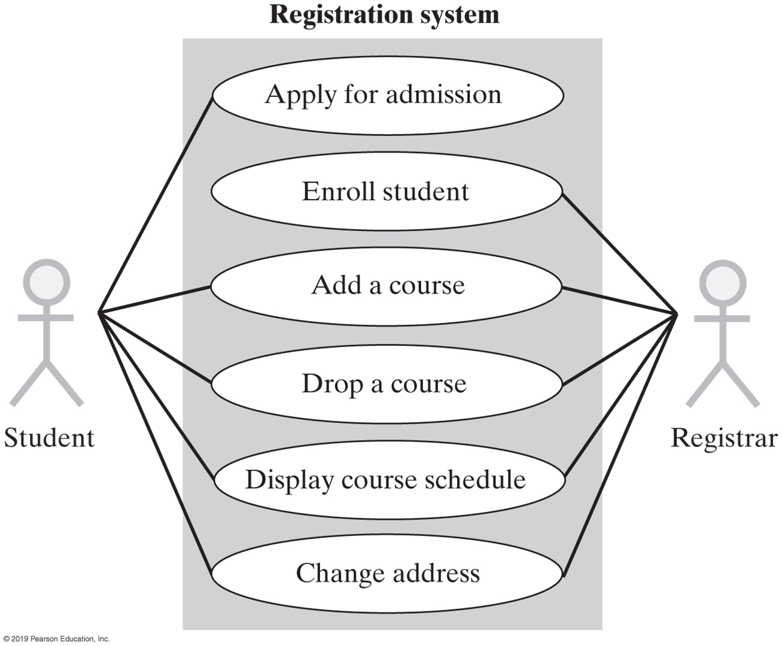
Activity | Registering Courses
ADT Course
Registration view
Faculty view
Financial view
Academic view
Notes:
An ADT typically abstracts “one” view, the one we care about the most
We could consider other views as needed

Slide 11
Abstraction
The idea of knowing how to use something without knowing how it is implemented
We know how to drive a car, but few of us could design and build one
Two types of abstractions in Computer Science
Procedural abstraction
Data abstraction (Abstract Data Types, ADTs)
Notes:
Abstraction applies to methods and data structures as well

Slide 12
Procedural Abstraction
To use a method
We need only to know
What it does (to decide when to invoke it); How to invoke it (its signature), but not how it works (its algorithm)
System.out.println()
Allow us to build upon others’ knowledge (algorithms) and efforts (method coding and debugging)
Examples
Selection Sort
Radix Sort
Java Standard Library
Notes:
Using soring as an example
We learn how to write a soring routine first (so that we know how to do so)
We then learn how to use (going forward)
https://www.geeksforgeeks.org/sorting-algorithms/

Slide 13
Data Abstraction (ADT)
Similarly, to utilize a data structure
We only need to know
What the operation methods do (to decide when to invoke them)
How to invoke the operation methods (their signature)
Examples | Queue & Stack
What we will learn in CMSC 204
Build ADTs
Utilize ADTs
Notes:
About 204, we learn to how to build and utilize data structures

Slide 14
Standard Abstract Data Type
An ADT whose method signatures conform to a standard
Advantage is that an application’s data structure can be changed by changing
The declaration of the data structure object
Not the operation method invocations
Greatly reduces the cost of software maintenance
Example: Declare the standard method signature to add an element to a data structure as:
boolean add(T element)
You could then change the data structure from an array based list to a linked list without having to change the method signature to add an element to the data structure. You wouldn’t have to worry that the method to add an element to your new data structure was called “insert” or “addItem”, etc.
Notes:
Standard ADT enables us -
NOT to worry about the “how” (something is being built)

Slide 15
The ADT Bag
Notes:
Think about the grocery bag that you use during checkout

Slide 16

ADT Bag
Definition
A finite collection of objects in no particular order
Can contain duplicate items
Possible behaviors
Add, remove objects
Check for empty
Get number of items
Notes:
You know how to use an array
It’s a build-in ADT that you get to use
We are here to build something similar, the ADT Bag

Slide 17
ADT Bag (UML Class Diagram)
Bag
+getCurrentSize(): integer +isEmpty(): boolean +add(newEntry: T): boolean +remove(): T +remove(anEntry: T): boolean +clear(): void +getFrequencyOf(anEntry: T): integer +contains(anEntry: T): boolean +toArray(): T[]

Slide 18
An Interface (1 of 2)
/** An interface that describes the operations of a bag of objects. */
public interface BagInterface<T>
{
/** Gets the current number of entries in this bag.
@return The integer number of entries currently in the bag. */
public int getCurrentSize();
/** Sees whether this bag is empty.
@return True if the bag is empty, or false if not. */
public boolean isEmpty();
/** Adds a new entry to this bag.
@param newEntry The object to be added as a new entry.
@return True if the addition is successful, or false if not. */
public boolean add(T newEntry);
/** Removes one unspecified entry from this bag, if possible.
@return Either the removed entry, if the removal.
was successful, or null. */
public T remove();
Notes:
What’s an interface?
Why do we need this BagInterface?
It’s derived from the UML class diagram

Slide 19
An Interface (2 of 2)
/** Removes one occurrence of a given entry from this bag, if possible.
@param anEntry The entry to be removed.
@return True if the removal was successful, or false if not. */
public boolean remove(T anEntry);
/** Removes all entries from this bag. */
public void clear();
/** Counts the number of times a given entry appears in this bag.
@param anEntry The entry to be counted.
@return The number of times anEntry appears in the bag. */
public int getFrequencyOf(T anEntry);
/** Tests whether this bag contains a given entry.
@param anEntry The entry to find.
@return True if the bag contains anEntry, or false if not. */
public boolean contains(T anEntry);
/** Retrieves all entries that are in this bag.
@return A newly allocated array of all the entries in the bag.
Note: If the bag is empty, the returned array is empty. */
public T[] toArray();
} // end BagInterface

Slide 20
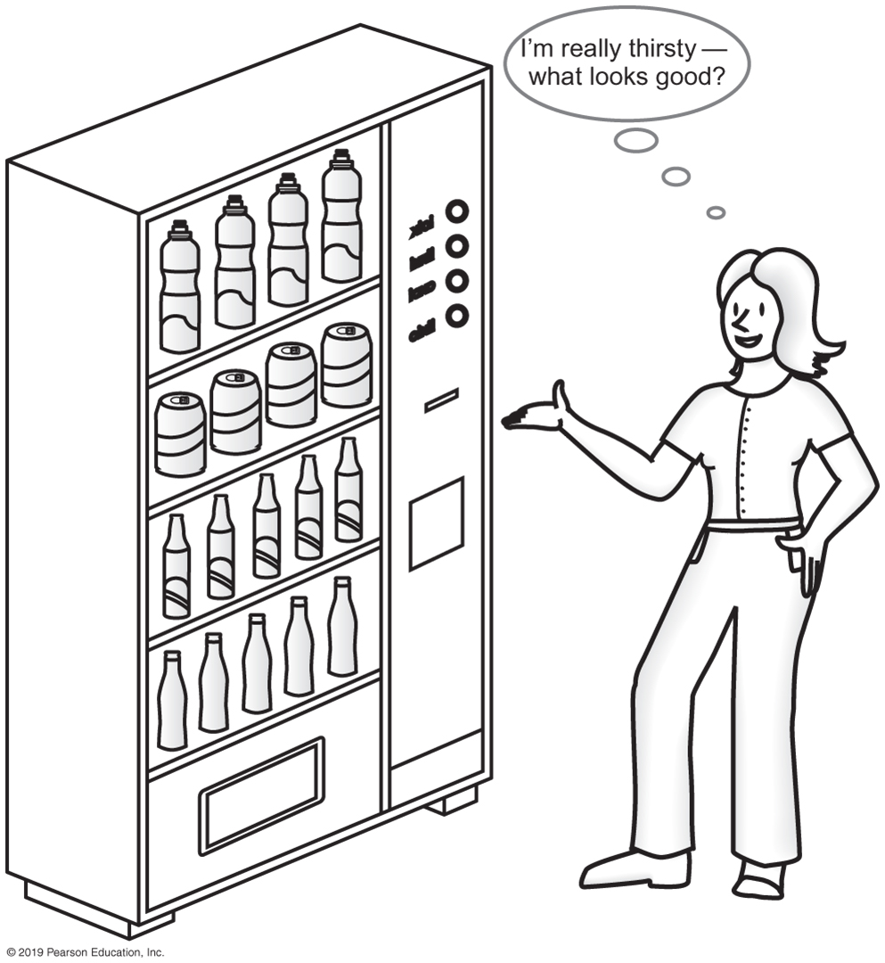
Vending Machine
Can perform only tasks machine’s interface presents
You must understand these tasks
Cannot access the inside of the machine
You can use the machine even though you do not know what happens inside
Usable even with an “upgraded" inside
Similar to the “car” we discussed earlier
Notes:
In real life, this is what happens

Slide 21
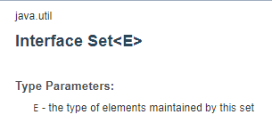
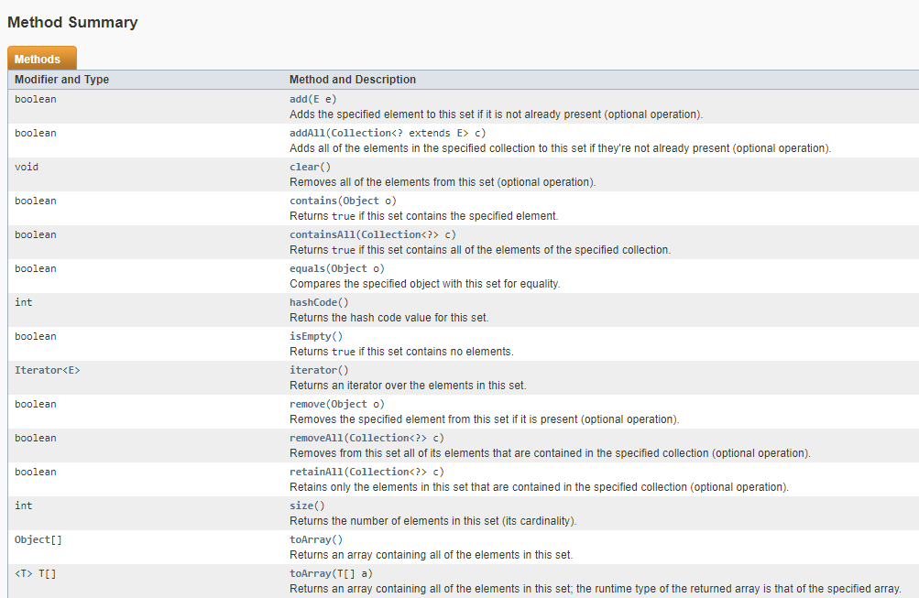
Java Class Library
Notes:
https://docs.oracle.com/javase/8/docs/api/java/util/Set.html
https://docs.oracle.com/javase/8/docs/technotes/guides/collections/overview.html
https://docs.oracle.com/en/java/javase/11/docs/api/java.base/java/util/Collections.html

Slide 22
The Java Collection Framework
The Java Collections Framework is a library of classes and interfaces for working with collections of objects
A collection is an object which can store other objects, called elements. Collections provide methods for adding and removing elements, and for searching for a particular element within the collection

Slide 23
Interface Set | Java Collection Framework
https://docs.oracle.com/javase/8/docs/technotes/guides/collections/overview.html
Why is there no direct implementation of Bag in Java collection framework?
/** An interface that describes the operations of a set of objects. */
public interface SetInterface<T>
{
public int getCurrentSize();
public boolean isEmpty();
/** Adds a new entry to this set, avoiding duplicates.
@param newEntry The object to be added as a new entry.
@return True if the addition is successful, or
false if the item already is in the set. */
public boolean add(T newEntry);
/** Removes a specific entry from this set, if possible.
@param anEntry The entry to be removed.
@return True if the removal was successful, or false if not. */
public boolean remove(T anEntry);
public T remove();
public void clear();
public boolean contains(T anEntry);
public T[] toArray();
} // end SetInterface
Notes:
+ https://stackoverflow.com/questions/15608667/why-is-there-no-direct-implemention-of-bag-in-java-collection-framework

Slide 24
CRC Card
Bag
Responsibilities
Get the number of items currently in the bag
See whether the bag is empty
Add a given object to the bag
Remove an unspecified object from the bag
Remove a particular object from the bag, if possible
Remove all objects from the bag
Count the number of times a certain object occurs in the bag
Test whether the bag contains a particular object
Look at all objects that are in the bag
Collaborations
The class of objects that the bag can contain
https://en.wikipedia.org/wiki/Class-responsibility-collaboration_card

Slide 25
Design Decision
How do we handle unusual conditions?
Assume it won’t happen
Ignore invalid situations
What conditions are we talking about?
Return value that signals a problem
Return a Boolean
Throw an exception

Slide 26
Take-Home Activities
If you have time, get Activities 1 & 2 (subsequent slides) to work

Slide 27
Activity 1 : Online Shopper (ADT Bag)
/** A class that maintains a shopping cart for an online store. */
public class OnlineShopper
{
public static void main(String[] args)
{
Item[] items = {new Item("Bird feeder", 2050),
new Item("Squirrel guard", 1547),
new Item("Bird bath", 4499),
new Item("Sunflower seeds", 1295)};
BagInterface<Item> shoppingCart = new Bag<>();
int totalCost = 0;
// Statements that add selected items to the shopping cart:
for (int index = 0; index < items.length; index++)
{
Item nextItem = items[index]; // Simulate getting item from shopper
shoppingCart.add(nextItem);
totalCost = totalCost + nextItem.getPrice();
} // end for
// Simulate checkout
while (!shoppingCart.isEmpty())
System.out.println(shoppingCart.remove());
System.out.println("Total cost: " + "\t$" + totalCost / 100 + "." +
totalCost % 100);
} // end main
} // end OnlineShopper
Program Output
Sunflower seeds $12.95
Bird bath $44.99
Squirrel guard $15.47
Bird feeder $20.50
Total cost: $93.91
Notes:
Complete this activity to grasp what we have learned

Slide 28
Activity 2: A Piggy Bank (1 of 3)
/** A class that implements a piggy bank by using a bag. */
public class PiggyBank
{
private BagInterface<Coin> coins;
public PiggyBank()
{
coins = new ArrayBag<>();
} // end default constructor
public boolean add(Coin aCoin)
{
return coins.add(aCoin);
} // end add
public Coin remove()
{
return coins.remove();
} // end remove
public boolean isEmpty()
{
return coins.isEmpty();
} // end isEmpty
} // end PiggyBank
Notes:
Consider completing this activity as well

Slide 29
Activity 2: A Piggy Bank (2 of 3)
/** A class that demonstrates the class PiggyBank. */
public class PiggyBankExample
{
public static void main(String[] args)
{
PiggyBank myBank = new PiggyBank();
addCoin(new Coin(1, 2010), myBank);
addCoin(new Coin(5, 2011), myBank);
addCoin(new Coin(10, 2000), myBank);
addCoin(new Coin(25, 2012), myBank);
System.out.println("Removing all the coins:");
int amountRemoved = 0;
while (!myBank.isEmpty())
{
Coin removedCoin = myBank.remove();
System.out.println("Removed a " + removedCoin.getCoinName() + ".");
amountRemoved = amountRemoved + removedCoin.getValue();
} // end while
System.out.println("All done. Removed " + amountRemoved + " cents.");
} // end main

Slide 30
Activity 2: A Piggy Bank (3 of 3)
private static void addCoin(Coin aCoin, PiggyBank aBank)
{
if (aBank.add(aCoin))
System.out.println("Added a " + aCoin.getCoinName() + ".");
else
System.out.println("Tried to add a " + aCoin.getCoinName() +
", but couldn't");
} // end addCoin
} // end PiggyBankExample
Program Output
Added a PENNY.
Added a NICKEL.
Added a DIME.
Added a QUARTER.
Removing all the coins:
Removed a QUARTER.
Removed a DIME.
Removed a NICKEL.
Removed a PENNY.
All done. Removed 41 cents.

